Slide 1
The Nature of Information Technology Projects
Chapter 1

Slide 2
Learning Objectives
Understand the current state of IT project management and how successfully managing IT projects remains a challenge for most organizations.
Explain the value-driven, socio-technical, project management and knowledge management approaches
Define what a project is and describe its attributes.
Define the discipline called project management.
Define Triple Constraint
Identify the Project Management Body of Knowledge (PMBOK®) core knowledge areas.

Slide 3






IT and Modern Day Project Management
1940s
1950s
1960s
1970s
1980s
1990s
2000s
2010s
First
Electronic
Computer
EDP
Era
PC
Era
Network
Era
Globalization

Slide 4
Dominant Eras of Information Systems
EDP era (1960):
  Mainframe computers
  Automating organizational transactions (accounting, inventory mgmt)
  Goal: improve efficiency and reduce costs
  IT Projects are structured, long term, requirements are stable
  Problem: systems don’t talk to each other
PC era (1980):
  Personal computers
  User developed, independent system (ubiquitous IT)
  Problem: security, data integrity, maintenance, and sharing of data
  IT Projects are shorter, cross functional

Slide 5
Dominant Eras of Information Systems
Network era (1990):
  Networked computers
  Goal: creating an IT infrastructure to support partners, vendors and customers
  Problem: how to support new business model and strategy
  IT Projects require scalability
Globalization era (2000):
  Work with anyone in anywhere at anytime
  IT projects are dynamic, geographically dispersed, and culturally diverse
  IT Project Management becomes more challenging and rewarding than previous eras

Slide 6
Introduction
Information Technology (IT) projects are organizational investments that require
  Time
  Money
  And other resources such as people, technology, facilities, etc.
Organizations expect some type of value in return for this investment
IT Project Management is a relatively new discipline that attempts to make IT projects more successful and combines traditional Project Management with Software Engineering/Management Information Systems

Slide 7
Why Do IT Projects Fail?
Larger projects have the lowest success rate and appear to be more risky than medium and smaller projects
  Technology, business models, and markets change too rapidly so projects that take more than a year can be obsolete before they are completed

Slide 8
The Software Crisis
The CHAOS study published in 1995 by The Standish Group found that although the U.S spent over $250 billion on IT projects, approximately…
  31% were cancelled before completion
  53% were completed but over budget, over schedule, & did not meet original specifications
    For mid-size companies, average cost overruns were 182%, while average schedule overruns were 202%!

Slide 9
Table 1.1 Summary of CHAOS Study Factor Rankings for Successful Projects
Sources: Adapted from the Standish Group. CHAOS (West Yarmouth, MA: 1995) & http://www.infoq.com/articles/Interview-Johnson-Standish-CHAOS
Rank | 1994 | 2001 | 2006
1 | User Involvement | Executive Support | User Involvement
2 | Executive Management Support | User Involvement | Executive Management Support
3 | Clear Statement of Requirements | Experienced Project Manager | Clear Business Objectives
4 | Proper Planning | Clear Business Objectives | Optimizing Scope
5 | Realistic Expectations | Minimized Scope | Agile Process
6 | Smaller Project Milestones | Standard Software Infrastructure | Project Management Expertise
7 | Competent Staff | Firm Basic Requirements | Financial Management
8 | Ownership | Formal Methodology | Skilled Resources
9 | Clear Vision & Objectives | Reliable Estimates | Formal Methodology
10 | Hard-working, focused team | Other | Standard Tools and Infrastructure

Slide 10
Table 1.3: Summary of Factor Rankings for Challenged and Failed (Impaired) Projects
Source: Adapted from the Standish Group. CHAOS (West Yarmouth, MA: 1995)
Rank | Factors for Challenged Projects | Factors for Failed (Impaired) Projects
1 | Lack of user input | Incomplete requirements
2 | Incomplete requirements | Lack of user involvement
3 | Changing requirements & specifications | Lack of resources
4 | Lack of executive support | Unrealistic expectations
5 | Technology incompetence | Lack of executive support
6 | Lack of resources | Changing requirements & specifications
7 | Unrealistic expectations | Lack of planning
8 | Unclear objectives | Didn’t need it any longer
9 | Unrealistic time frames | Lack of IT management
10 | New technology | Technology illiteracy

Slide 11
Has the Current State of IT Projects Changed Since 1994?
The Standish Group has continued to study IT projects over the years.
In general, IT Projects are showing higher success rates due to
  Better project management tools & processes
  Smaller projects
  Improved communication among stakeholders
  More skillful IT project managers
But there is still ample opportunity for improvement!

Slide 12
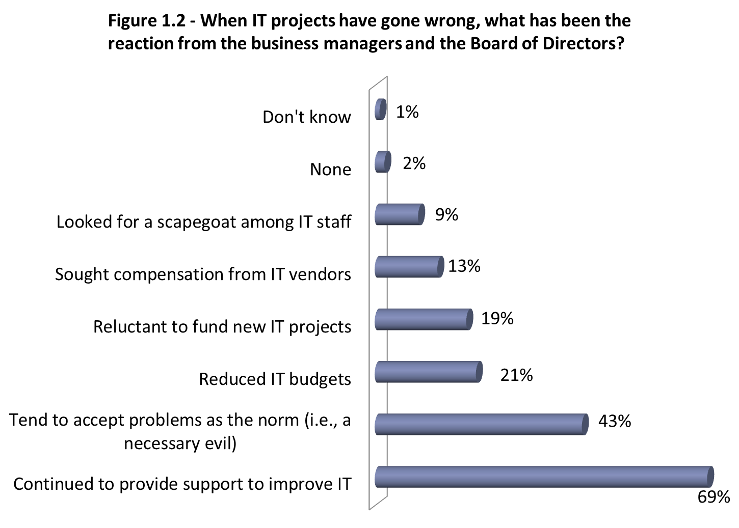

Slide 13
Improving the likelihood of success
A Value-Driven Approach
  Plain & Simple: IT Projects must provide value to the organization
  The value could be:
    Better customer service
    More efficient business processes
    Lower costs
    Expanded market share
  The project success should be measured by value, not by budget or schedule
Socio-technical Approach
  It’s not just about the technology or building a better mouse trap
  The IT professionals must understand the business
  The customers/clients must become stakeholders in the project

Slide 14
Improving the likelihood of success
Project Management Approach
  Applying PM methodology: defining processes, controls, tools, standards, and deliverables across entire organization
    resources could be better allocated and controlled
    expectations could be better communicated and managed
    competition could be encouraged
    efficiency and effectiveness could be achieved
Knowledge Management Approach
  lessons learned, best practices & shared knowledge

Slide 15
The PMBOK® Guide’s Definitions for Project and Project Management
A project is a temporary endeavor undertaken to create a unique product, service, or result.
Project Management is the application of knowledge, skills, tools and techniques to project activities to meet project requirements. Managing a project includes:
  Identifying requirements
  Establishing clear and achievable objectives
  Balancing the competing demands for quality, scope, time, and cost
  Adapting the specifications, plans, and approaches to the different concerns and expectations of the various stakeholders

Slide 16
The Context of Project Management – Project Attributes
Time Frame
Purpose (to provide value!)
Owner and Sponsor
Resources (the triple constraint)
Roles
  Project Manager
  Project Sponsor
  Subject Matter Experts (SME) – domain
  Technical Experts (TE)
Risk & Assumptions
  Internal risks: e.g. key members leave before the project is complete
  External risks: e.g. dependencies on outside contractors or vendors
Interdependent Tasks
  Some task cannot be started until other tasks are finished
  Progressive Elaboration – break down processes into smaller steps & increments
Organizational Change
  IT project will change the way people work, resistance should be expected
Operate in Environments Larger than the Project Itself
  IT project should be aligned properly with the structure and strategy of the organization

Slide 17
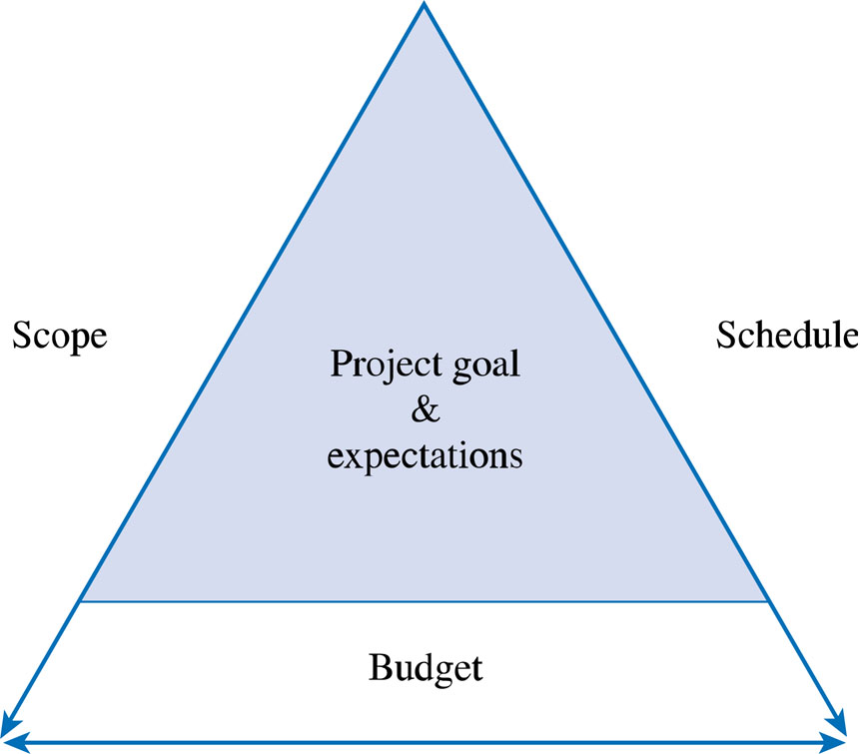
The Triple Constraint
Figure 1.3

Slide 18
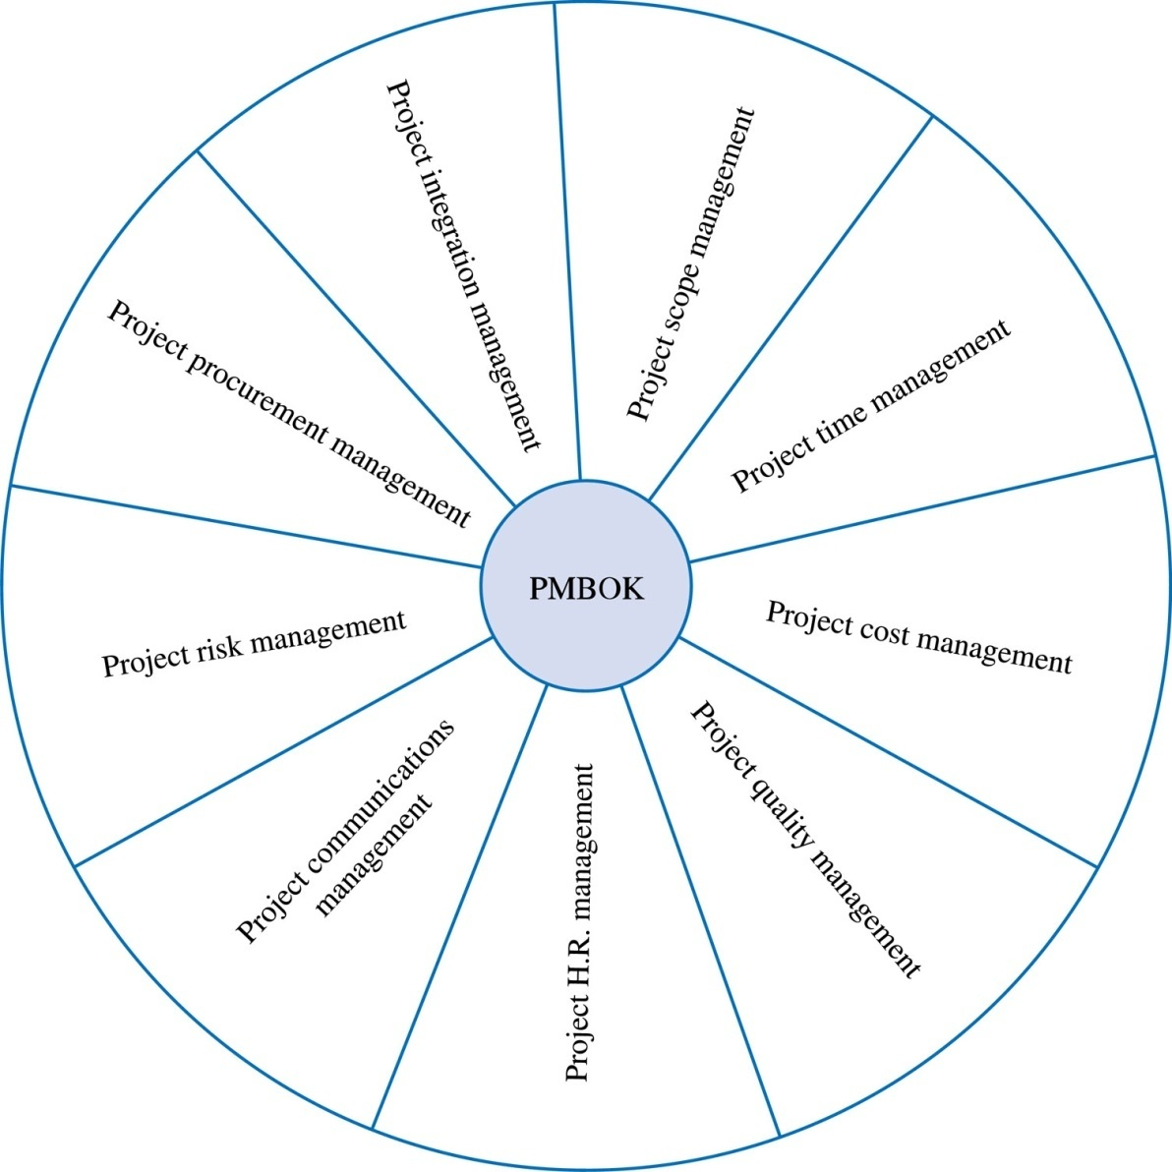
Project Management Body of Knowledge Areas
Figure 1.8

